Slide 1
C# & .NET Framework
Chapter 16: System .IO Namespace
Chapter 17: Object Serialization

Slide 2
Review
Process, Application Domain, Context, Thread
Issue of concurrency: race condition
Synchronized technique: lock(), [synchronization] attribute
TimerCallBack
ThreadPool

Slide 3
Chapter 16: Objectives
Exploring the System.IO Namespace
The Directory(Info) and File(Info) Types
Working with the DirectoryInfo Type
Working with the Directory Type .
Working with the DriveInfo Class Type
Working with the FileInfo Class
Working with the File Type
Working with StreamWriters and StreamReaders
Working with BinaryWriters and BinaryReaders

Slide 4

What is a file?
File:
A memory location that has a name.
File can be used as an extra memory to store a large amount of data temporarily or permanently
Each file ends with a marking-end-character or a number of bytes

Slide 5
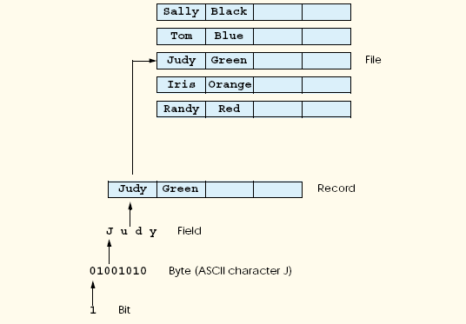
What is a file?
File structure

Slide 6
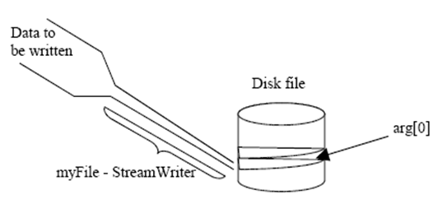
What is a file?
Stream: a chunk of data (sequence of bytes) containing information being passed through to store in memory storage

Slide 7
System.IO Namespace
I/O Class Type | Description
BinaryReader BinaryWriter | These types allow to store and retrieve primitive data types (integers, Booleans, strings, and whatnot) as a binary value.
BufferedStream | This type provides temporary storage for a stream of bytes that may be committed to storage at a later time
Directory DirectoryInfo | These types are used to manipulate directory structure. The Directory type exposes functionality primarily as static methods. The DirectoryInfo type exposes similar functionality from a valid object variable
DriveInfo | This type (new to .NET 2.0) provides detailed information regarding the drives on a given machine.
File FileInfo | These types are used to manipulate a set of files. The File type exposes functionality primarily as static methods. The FileInfo type exposes similar functionality from a valid object variable

Slide 8
System.IO Namespace
I/O Class Type | Description
FileStream | This type allows for random file access (e.g., seeking capabilities) with data represented as a stream of bytes.
FileSystemWatcher | This type allows you to monitor the modification of a given external file.
StreamWriter StreamReader | These types are used to store (and retrieve) textual information to (or from) a file. These types do not support random file access.

Slide 9
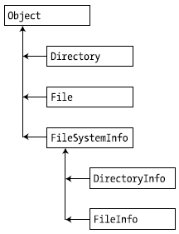
Directory(Info) and File(Info)
Directory and File expose creation, deletion, copying, and moving operations using various static members.
FileInfo and DirectoryInfo types expose similar functionality as instance-level methods (and therefore must be “new-ed”).

Slide 10
DirectoryInfo Type
Members | Description
Create() CreateSubdirectory() | Create a directory (or set of subdirectories), given a path name
Delete() | Deletes a directory and all its contents
GetDirectories() | Returns an array of strings that represent all sub directories in the current directory
GetFiles() | Retrieves an array of FileInfo types that represent a set of files in the given directory
MoveTo() | Moves a directory and its contents to a new path
Parent | Retrieves the parent directory of the specified path
Root | Gets the root portion of a path

Slide 11
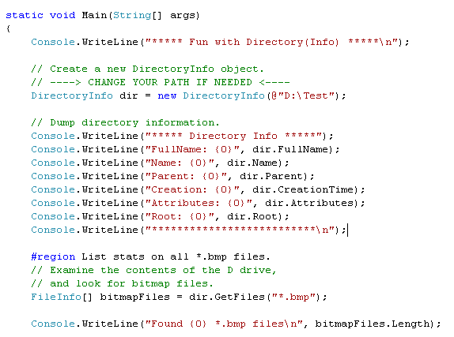
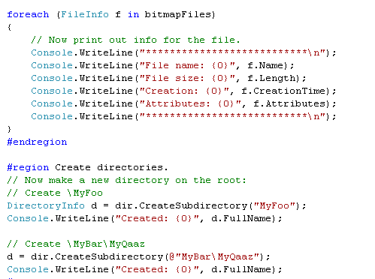
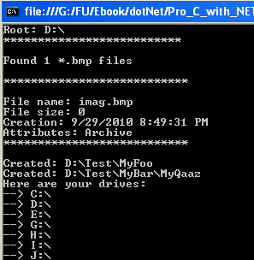
DirectoryInfo Demo (Ch_16 Code\MyDirectoryApp)

Slide 12
FileInfo Class
Members | Description
AppendText() | Creates a StreamWriter type that appends text to a file
CopyTo() | Copies an existing file to a new file
Create() | Creates a new file and returns a FileStream type (described later) to interact with the newly created file
CreateText() | Creates a StreamWriter type that writes a new text file
Delete() | Deletes the file to which a FileInfo instance is bound
Directory | Gets an instance of the parent directory
DirectoryName | Gets the full path to the parent directory
Length | Gets the size of the current file or directory
MoveTo() | Moves a specified file to a new location, providing the option to specify a new filename

Slide 13
FileInfo Class
Members | Description
Name | Gets the name of the file
Open() | Opens a file with various read/write and sharing privileges
OpenRead() | Creates a read-only FileStream
OpenText() | Creates a StreamReader type (described later) that reads from an existing text file
OpenWrite() | Creates a write-only FileStream type

Slide 14
FileInfo Class
The FileInfo.Create() Method
If the file is already existed, this file will be overwritten by the new one
The FileInfo.Open() Method
FileInfo f2 = new FileInfo(@"C:\Test2.dat");
FileStream fs2 = f2.Open( FileMode.OpenOrCreate,
FileAccess.ReadWrite, FileShare.None);
FileMode.CreateNew: If the file already exists, a System.IO.IOException is thrown.
FileMode.Create: if the file already existed, it will be overwritten
FileMode.OpenOrCreate: Specifies that the operating system should open a file if it exists; otherwise, a new file should be created
FileMode.Open: if the file does not exist, a System.IO.IOException is thrown.
FileAccess.ReadWrite: Open to read and write
FileAccess.Read: Open to read only
FileAccess.Write : Open to write only

Slide 15
FileInfo Class
FileInfo.OpenRead():Open to read file only
FileInfo.OpenWrite(): Open to write to file only
The FileInfo.OpenText(): Return a StreamReader to open and read file from stream
The FileInfo.CreateText() : Creates a StreamWriter that writes a new text file
FileInfo.AppendText(): Creates a StreamWriter that appends text to the file

Slide 16
File Type
The File type provides functionality almost identical to that of the FileInfo type, using a number of static members.
New .NET 2.0 File Members
Method | Description
ReadAllBytes() | Opens the specified file, returns the binary data as an array of bytes, and then closes the file
ReadAllLines() | Opens a specified file, returns the character data as an array of strings, and then closes the file
ReadAllText() | Opens a specified file, returns the character data as a System.String, and then closes the file
WriteAllBytes() | Opens the specified file, writes out the byte array, and then closes the file
WriteAllLines() | Opens a specified file, writes out an array of strings, and then closes the file
WriteAllText() | Opens a specified file, writes the character data, and then closes the file

Slide 17
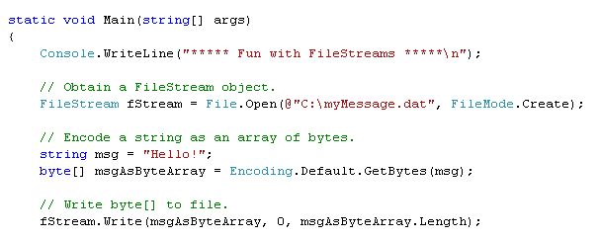
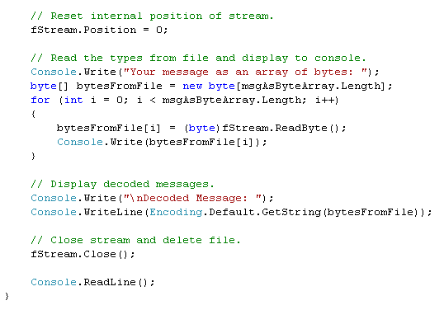
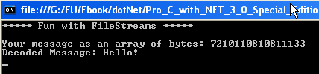
FileStreams Demo (Ch_16 Code\FileStreamApp)

Slide 18
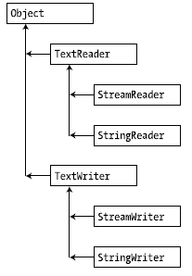
StreamWriters and StreamReaders
The StreamWriter and StreamReader classes are useful whenever you need to read or write character-based data (e.g., strings). Both of these types work by default with Unicode characters

Slide 19
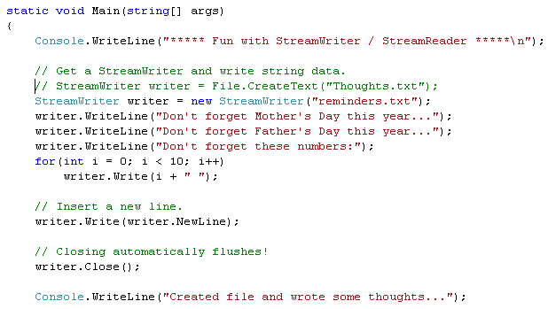
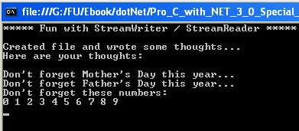
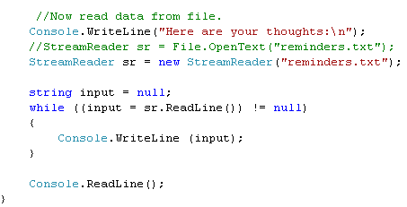
StreamWriter and StreamReader Demo (Ch_16 Code\StreamWriterReaderApp)

Slide 20
BinaryWriters and BinaryReaders
BinaryReader and BinaryWriter allow to read and write discrete data types to an underlying stream in a compact binary format

Slide 21
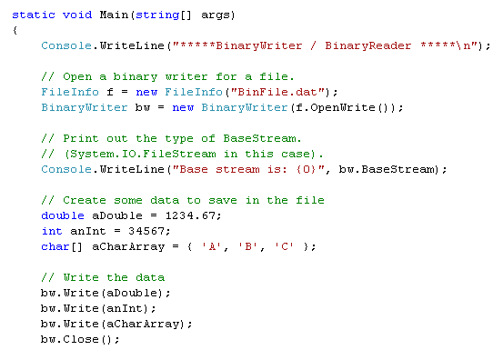
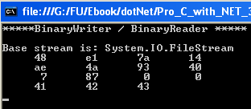
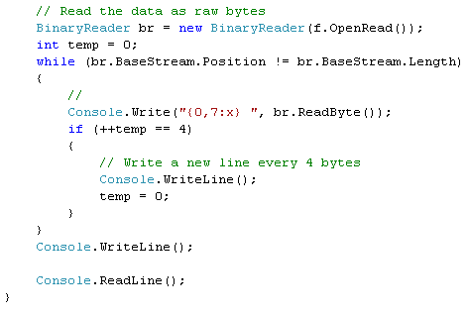
BinaryReader and BinaryWriter Demo (Ch_16 Code\BinaryWriterReaderApp)

Slide 22
Try yourself
AsyncFileStream example

Slide 23
Summary
Working with the DirectoryInfo Type
Working with the Directory Type .
Working with the FileInfo Class
Working with the File Type
Working with StreamWriters and StreamReaders
Working with BinaryWriters and BinaryReaders

Slide 24
Chapter 16: Q & A
Notes:
The End.

Slide 25
C# & .NET Framework
Chapter 17
Object Serialization

Slide 26
Chapter 17: Objectives
Understanding Object Serialization
Configuring Objects for Serialization
Choosing a Serialization Formatter
Serializing Objects Using the BinaryFormatter
Serializing Objects Using the SoapFormatter
Serializing Objects Using the XmlSerializer.

Slide 27
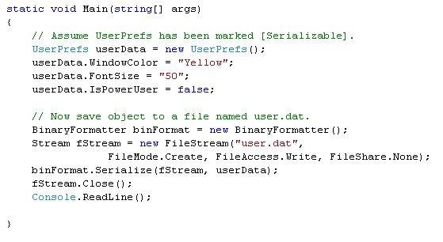
Object Serialization Concept
The term serialization describes the process of persisting (and possibly transferring) the state of an object to a stream.
The persisted data sequence contains all necessary information needed to reconstruct (or deserialize) the state of the object for use later.
Example: provide a way for end users to save their preferences to a GUI-based desktop application.

Slide 28
Object Serialization Concept
When an object is persisted to a stream, all associated data (base classes, contained objects, etc.) are automatically serialized as well.
A set of interrelated objects is represented using an object graph.
.NET serialization services also allow you to persist an object graph in a variety of formats:
Compact binary format (previous example)
A Simple Object Access Protocol (SOAP) or XML format
An object graph can be persisted into:
Local file (using System.IO.Stream-derived type)
Memory (using MemoryStream type)

Slide 29
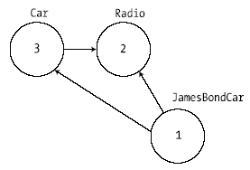
Object Serialization Concept
The Role of Object Graphs
The set of related objects is collectively referred to as an object graph.
Object graphs provide a simple way to document how a set of objects refer to each other
Each object in an object graph is assigned a unique numerical value.
Once all objects have been assigned a numerical value, the object graph can record each object’s set of dependencies.

Slide 30
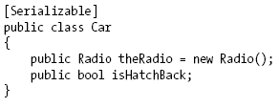
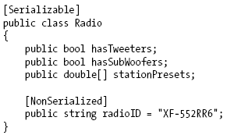
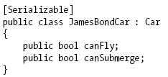
Configuring Objects for Serialization
Decorate each related class with the [Serializable] attribute to make an object available to .NET serialization services.
Mark fields with [NonSerialized] if they should not (or perhaps cannot) participate in the serialization scheme.
The [Serializable] attribute cannot be inherited.

Slide 31
Configuring Objects for Serialization
Public Fields, Private Fields, and Public Properties
BinaryFormatter serialize all serializable fields of a type, regardless of whether they are public fields, private fields, or private fields exposed through type properties.
XmlSerializer or SoapFormatter only serialize public field data or private data exposed through public properties.

Slide 32
Choosing a Serialization Formatter
BinaryFormatter serializes object graph as compact binary format.
SoapFormatter represents graph as a SOAP message.
XmlSerializer persists an object graph as an XML document

Slide 33
Choosing a Serialization Formatter
BinaryFormatter type, it will not only persist the field data of the objects in the object graph, but also each type’s fully qualified name and the full name of the defining assembly
ideal choice for transferring objects by value (e.g., as a full copy) across machines
The SoapFormatter and XmlSerializer only persist public field data/public properties
ideal choices for transferring among OS (Windows XP, Mac OS X, and *nix distributions) and application framework (.NET, J2EE, COM, etc.)

Slide 34
Serializing Objects Using the BinaryFormatter
Serialize(): Persists an object graph to a specified stream as a sequence of bytes
Deserialize(): Converts a persisted sequence of bytes to an object graph

Slide 35
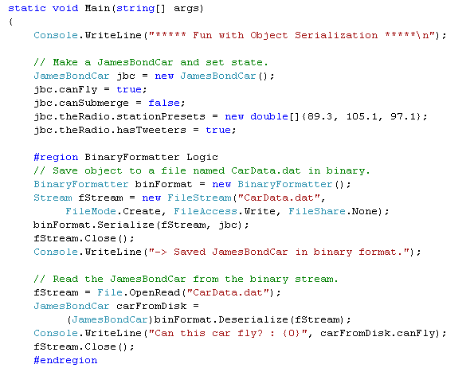
Serializing Objects Using the BinaryFormatter
Example (Ch_17 Code\SimpleSerialization)
Serialize
Deserialize

Slide 36
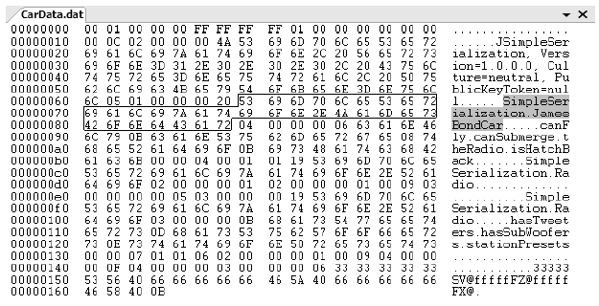
Serializing Objects Using the BinaryFormatter
JamesBondCar serialized using a BinaryFormatter

Slide 37
Serializing Objects Using the SoapFormatter
The SoapFormatter will persist an object graph into a SOAP message, which makes this formatter a solid choice when you wish to distribute objects remotely using the HTTP protocol.
SOAP defines a standard process in which methods may be invoked in a platform- and OS-neutral manner (discussion of XML web services).

Slide 38
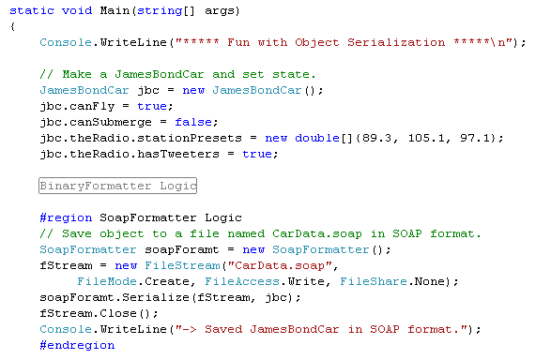
Serializing Objects Using the SoapFormatter
Example: Ch_17 Code\SimpleSerialization

Slide 39
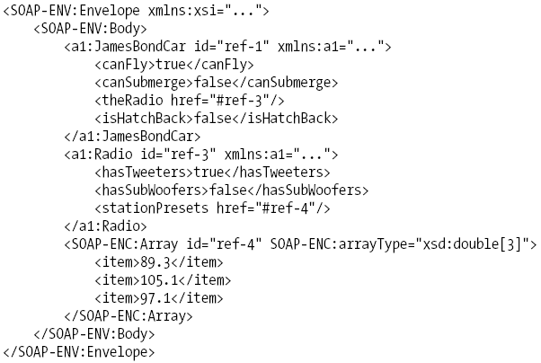
XML elements, which mark the stateful values of the current JamesBondCar,
as well as the relationship between the objects can be located in the
graph via the #ref tokens.

Slide 40
Serializing Objects Using the XmlSerializer
XmlSerializer: persisting the state of a given object as pure XML, as opposed to XML data wrapped within a SOAP message.

Slide 41
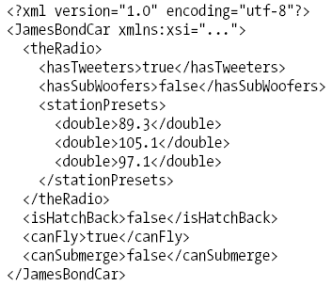
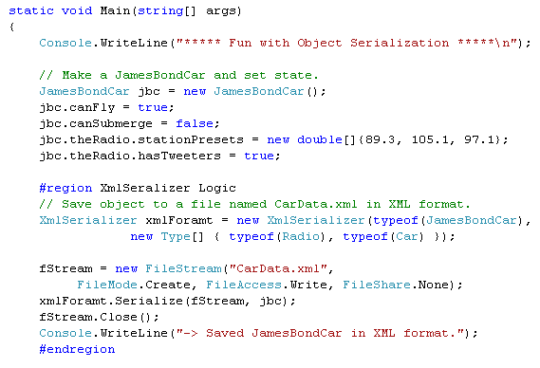
Example: Ch_17 Code\SimpleSerialization
The first constructor argument of the XmlSerializer defines
the root element of the XML file, while the second argument
is an array of System.Type types that hold metadata
regarding the subelements

Slide 42
Serializing Objects Using the XmlSerializer
Note The XmlSerializer demands that all serialized types in the object graph support a default constructor. If this is not the case, you will receive an InvalidOperationException at runtime.

Slide 43
Lab
Create a class named Book which contains: name, author, publisher, published year.
Write a console program that supports the following features:
Store a list of Book objects into a binary file. However, the published year will not be stored. All the book details are taken from users
Remove a book object from the list

Slide 44
Summary
Object Serialization: the process of persisting the state of an object to a stream
Configuring Objects for Serialization: [Serializable], [NonSerialized]
Serializing Objects Using the BinaryFormatter
Serializing Objects Using the SoapFormatter
Serializing Objects Using the XmlSerializer.

Slide 45
Chapter 17: Q & A

